Slide 1
TOOLBOX
“KESELAMATAN BEKERJA DI KAWASAN BERHAMPIRAN AIR”
Department of Technical Liaison
Date : 08 August 2018
Time : 8.30 am
Venue : HQ KSSB

Slide 2
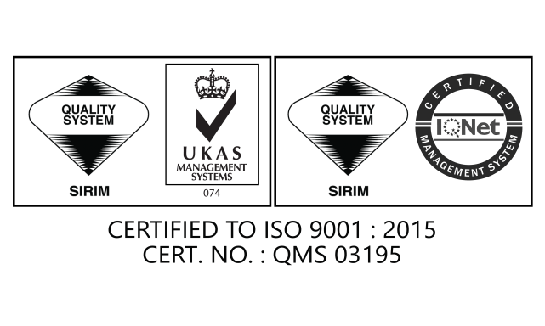
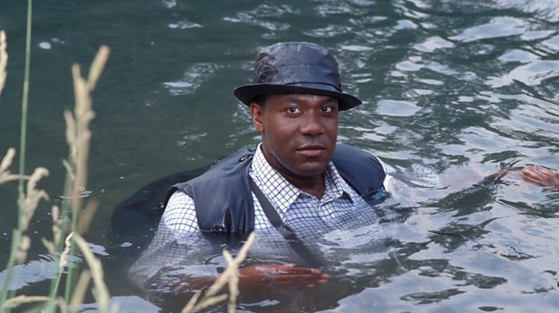
SAFETY GUIDE WORK
NEAR THE WATER
The purpose of these is to define the safe operating procedures in a manner that informs and instructs employees of the key health and safety points and controls to remember when working over or near water.

Slide 3
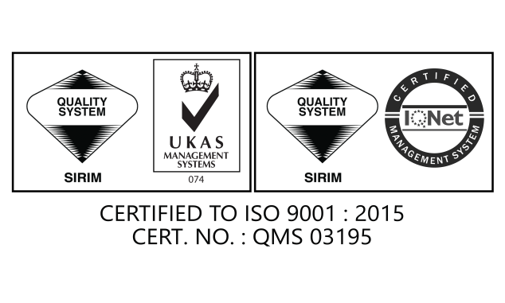
WHAT IS WORKING NEAR WATER
Working on or near bodies of water, including swimming pools, lakes, rivers, canals, quaysides and ports

Slide 4
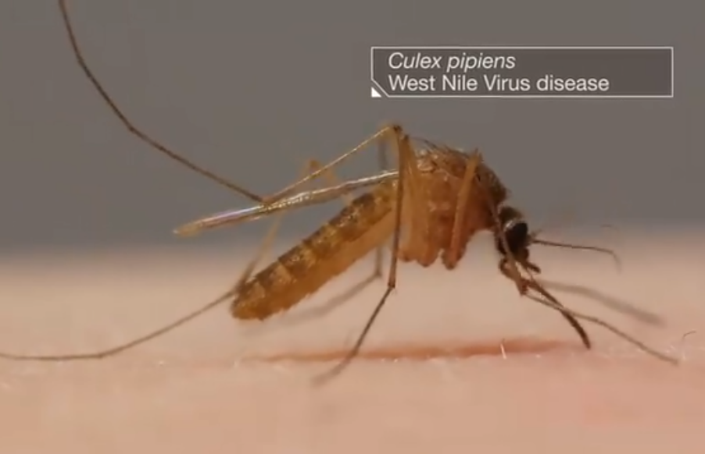
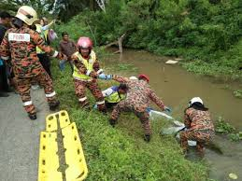
WHAT ARE THE RISK ?
hazard that need to be considered when working on or near water.
These include both safety and potential health issues. May include :
Vehicles, support, grips equipment falling into the water from unmarked edges, docksides, harbour walls and unstable banks etc
Slip or trip at the water’s edge, on pontoons, quaysides, when crossing boats and falling into water or drowning
Exposed to West Nile Virus

Slide 5
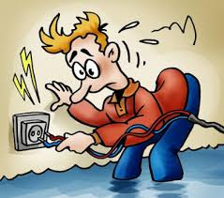
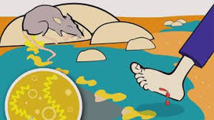
WHAT ARE THE RISK ?
Infections from rats’ urine (Leptospirosis).
Extreme weather (exposure to direct sunlight/ heat, cold).
Electric shock from use of electrical equipment.

Slide 6
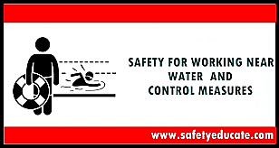
SAFE SYSTEM OF WORK
How do we reduce
health & safety risks when working near water

Slide 7
SAFE SYSTEM OF WORK
All potential hazard should be identified, listed out and addressed
Task-specific risk assessment for work near water should be conducted by a competent person
Safe work method should be properly implemented according to the safety plan
Assess the area of work and ground conditions, is it waterlogged and slippery

Slide 8
CONTROL MEASURE
The controls will vary depending on the work and situation involved and may include the following :
There must be an emergency plan, including provision for rescue and contact, if necessary, with the emergency services.
Working with a partner or team when working around or on water.
Communication devices are necessary, and they must be waterproof, suitable to the area of operation and tested before work commences.
Be aware of soft shoulders on edge of the water

Slide 9
CONTROL MEASURE
All electrical installations and equipment should be maintained to prevent the risk of danger from electric shock or burns.
As necessary, guard rails to prevent falling into water are required, eg on walkways and platforms.
Workers must know how to use rescue equipment such as “pole & life hook” and “ring buoy”; this can be demonstrated by certificated person.
Training and supervision are an essential part of adequate control measures.
Work on water can be very risky and only by adequate risk assessment will injuries, deaths and tragedies be prevented.

Slide 10
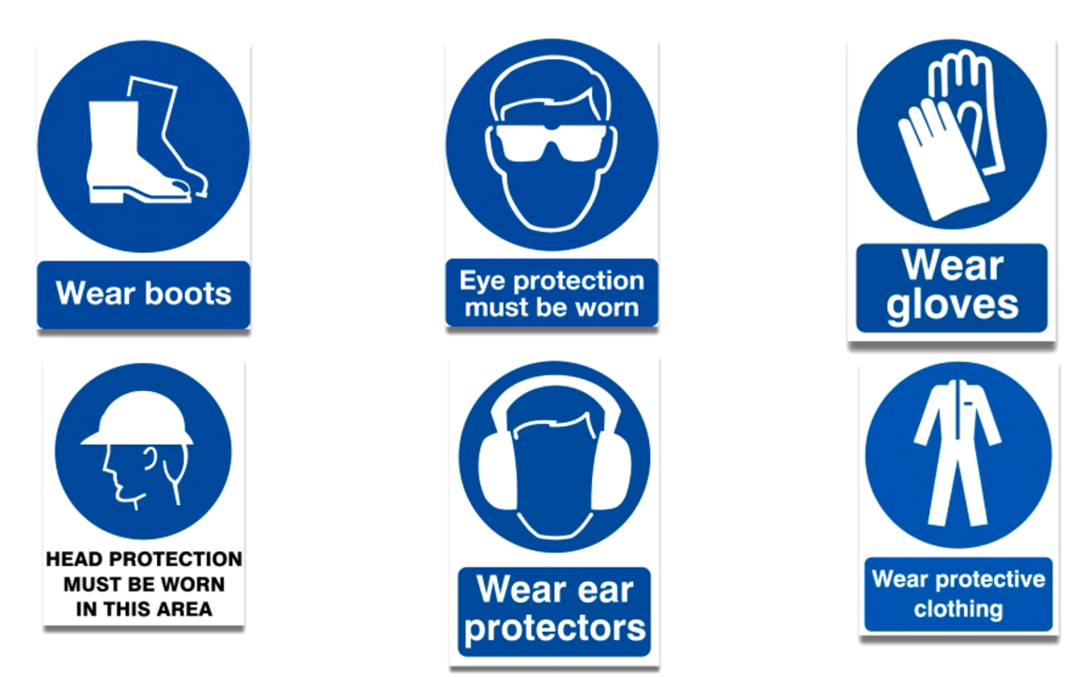
CONTROL MEASURE

Slide 11
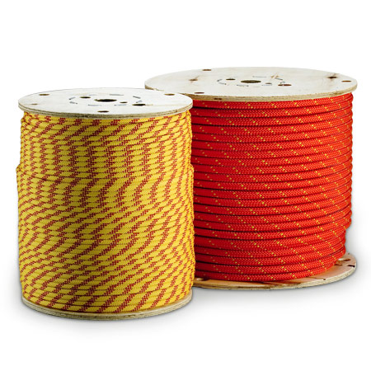
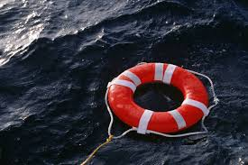
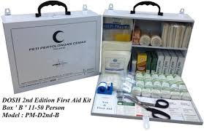
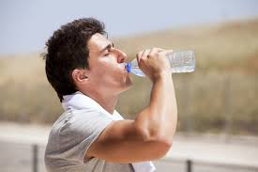
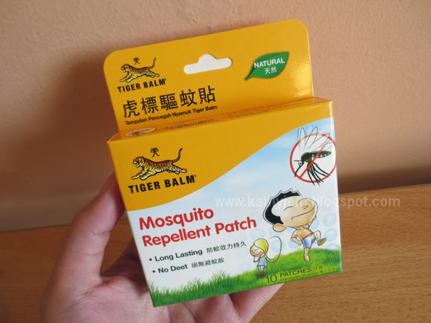
CONTROL MEASURE
MAKE SURE THE FOLLOWING SAFETY EQUIPMENT IS IN THE WORK AREA

Slide 12
SAFE USE OF LIFEJACKET/ BUOYANCY AID
The lifejacket/buoyancy aid should be provided with a whistle and/or a self-activating light in order to aid locating the wearer and facilitating rescue
The lifejackets/buoyancy aids should be inspected and checked periodically by a competent person
The lifejacket/buoyancy aids should be properly maintained
in a good serviceable condition according to the manufacturer’s instruction
The lifejacket should be serviced by an authorised agent at least once a year

Slide 13
“EXTRA PRECAUTION”
!!!!!!!!!!!!!!!!
Environmental conditions must be considered in the risk assessment and prior to commencing work
Wind speed
rainfall
Significant swell/surge
Sea level
The risk assessment must be reviewed
if conditions change
JANGAN SESEKALI BERDIRI DI BAHAGIAN BERTANDA “Y”
“Work should not commence where the environmental conditions pose a significant risk to the health and safety of personnel.”

Slide 14
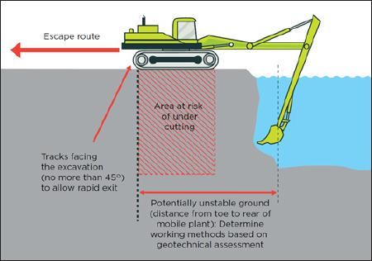
SAFE USE OF LIFTING APPLIANCES/MOBILE PLANT
▲ Lifting appliances should be tested and examined by a competent examiner
▲ Lifting appliances/mobile plant should be operated by qualified operators
▲ Lifting appliances/mobile plant should be properly maintained in safe working order.

Slide 15
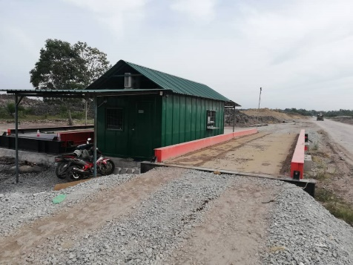
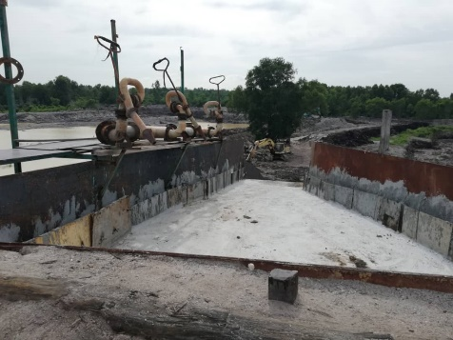
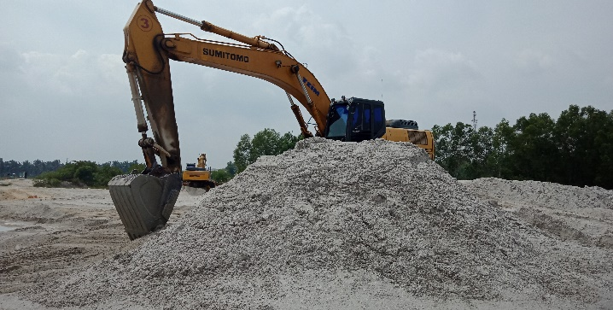
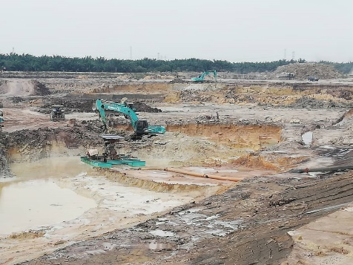
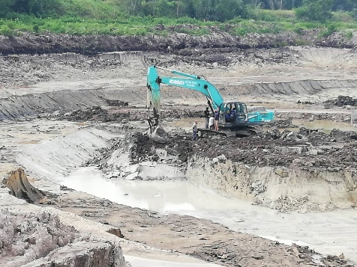
SAFE USE OF LIFTING APPLIANCES/MOBILE PLANT
▲ No lifting appliance/mobile plant should be loaded beyond its safe working load.
▲ Lifting appliances on vessels should be fixed and securely anchored.
▲ Lifting appliances/mobile plant should be kept away from dangerous locations such as openings, edges close to water.

Slide 16
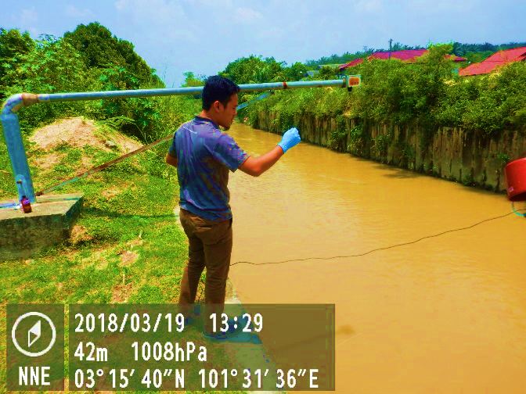
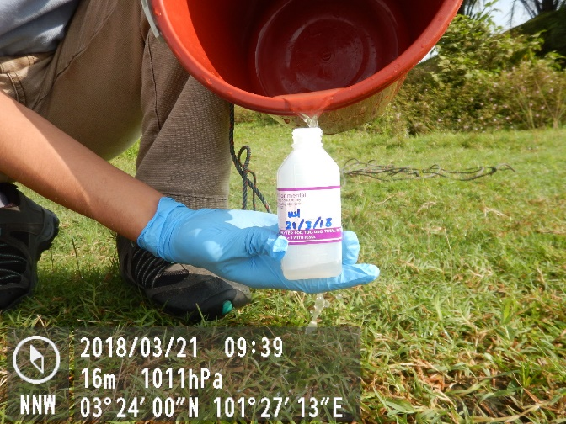
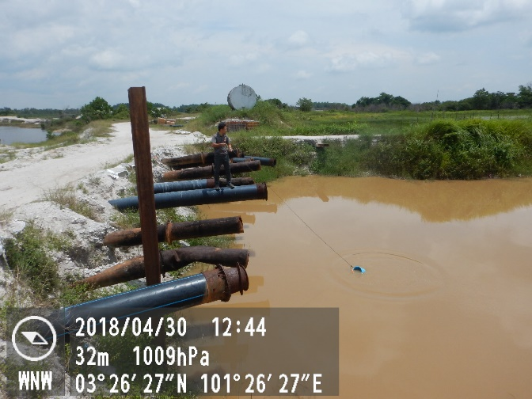
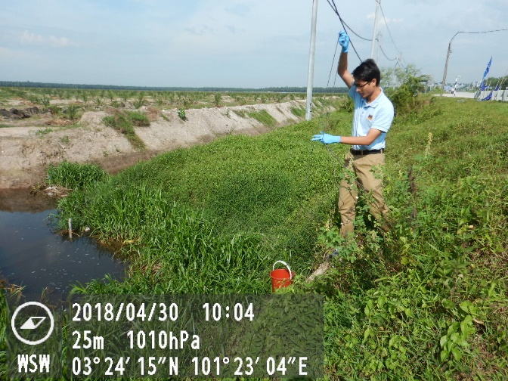
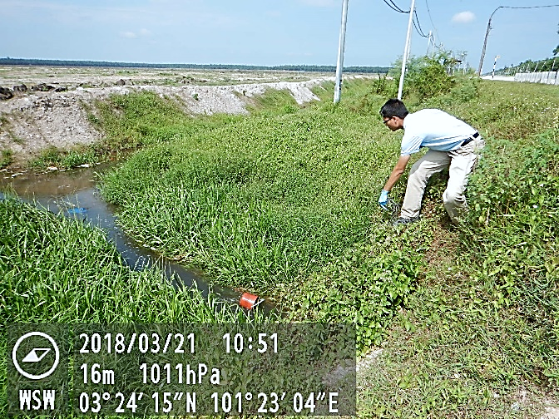
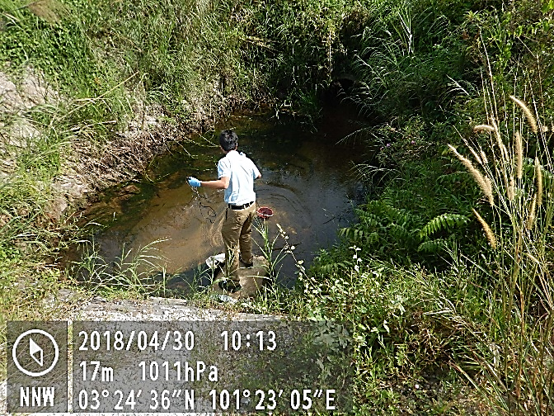
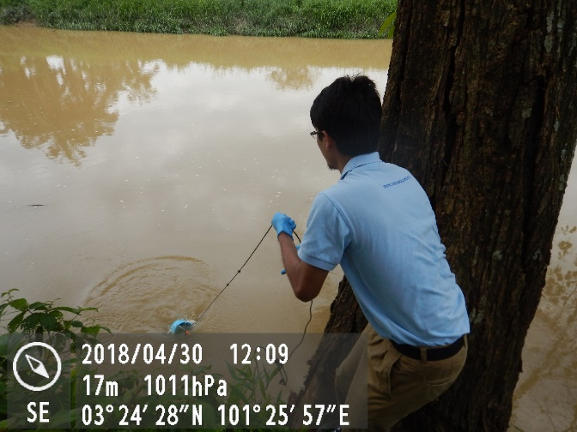
THANK YOU FOR LISTENING
Safety is everyone's business

